Slide 1
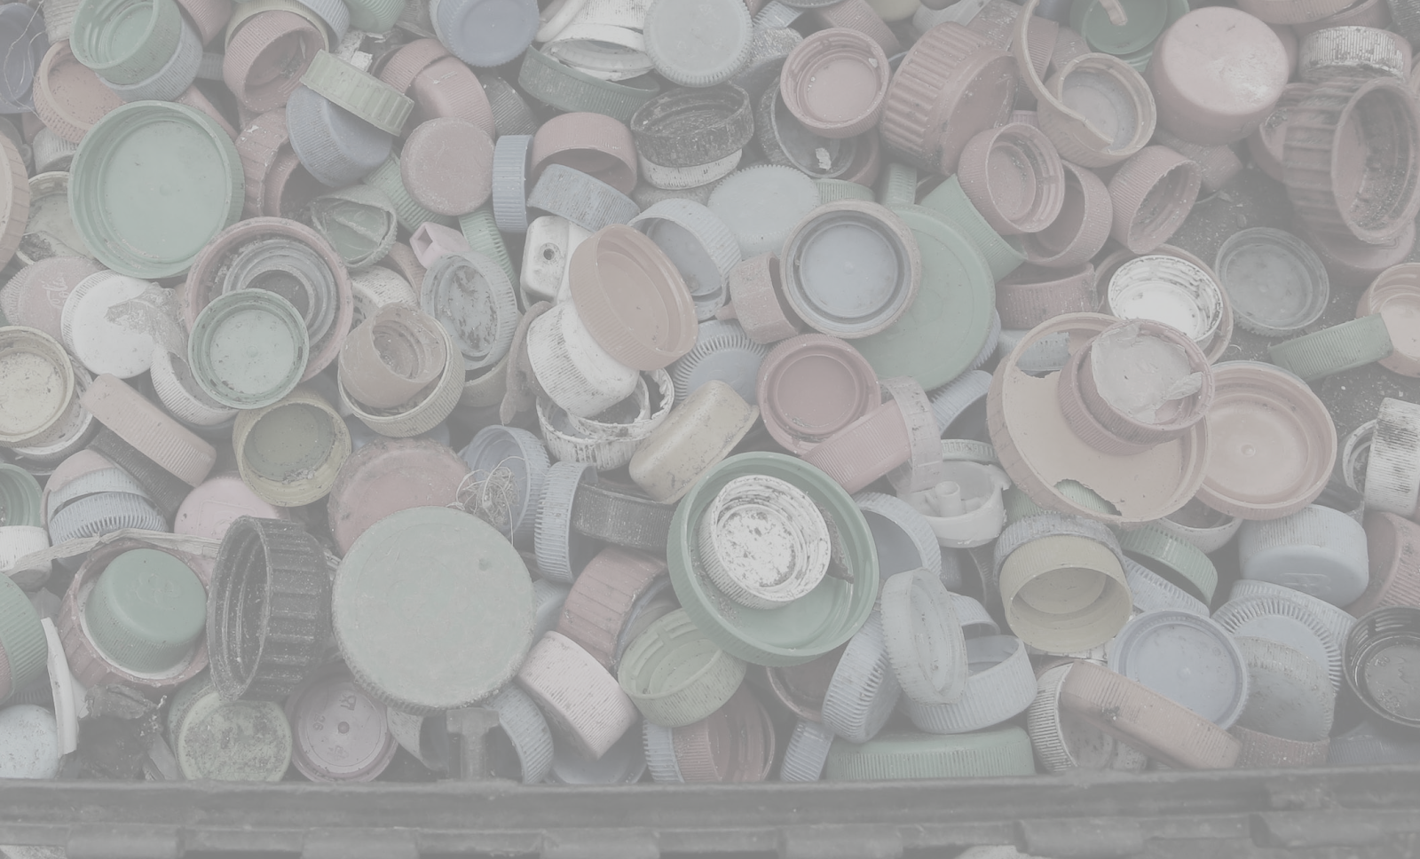
Green Team Presentation

Slide 2


Slide 3
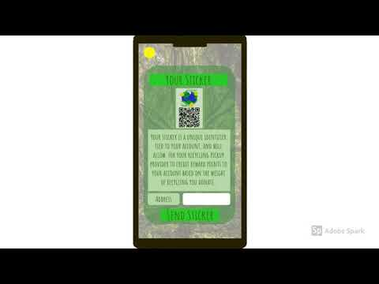

Slide 4

Green Team’s Product
Features/Products:
  RFID system
  Data stored into cloud Crashplan
  Raspberry Pi
  Recycling in conjunction with local pick-up system
Customer Base
  Pittsburgh, focusing on Oakland, Shadyside and Squirrel Hill

Slide 5
Green Team’s Value Proposition
Local City/Municipality
  Cleaner/more environmentally friendly city.
  Department of Environmental Protection provides economic incentives (grants) to cities based on how much they recycle.
Chain Companies
  Increase in customers due to points system.
Everyday People
  People that already want to recycle: Feel better about themselves, earn points that they can spend at local companies (eateries, clothing etc.)
  Increased knowledge on how to properly recycle.

Slide 6
Sources of Revenue
Sponsors from companies
  Companies pay for advertising
    Their coupons to put into our app
    Charge them business advertising fees and affiliate fees
Ads in app
  Points toward coupons to use toward a company
Banner ads
QR sticker sales
  People need to buy a QR code with RFID chip to put on their recycling bins to scan for pickup.

Slide 7


 | iRecycle | Recycle Nation | Us
Offers location services to find your nearest recycling center
Allow user to discover if a certain material is recyclable?
Directly works with local government to make recycling more prevalent in their communities
Provide Incentive to increase recycling
Tracks recycling

Slide 8
Sources of Financing
Enter product into Innovation competitions to raise awareness and meet startup costs
  i.e. Randall Family Big Idea Competition, PiNCh, etc.
Apply for funds from Innovation Works in Pittsburgh
  Technology-based startups in Pittsburgh
Grants from the government
  EPA’s P3 Program
    Especially for students
  Rockefeller Brothers Fund Sustainable Development

Slide 9
Obstacles/Future Milestones
Obstacles
  Initial costs:
    Raspberry Pi (200 dollars per truck)
    Clash plan (10 dollars per month per truck)
  Reliance of cooperation of local recycling companies
Future
  Begin in Oakland, Shadyside and Squirrel Hill
  Expand throughout the rest of Pittsburgh
  Prize money will manage startup costs

Slide 10
Questions?

Slide 11
References
http://www.post-gazette.com/local/city/2015/06/03/Recycling-of-solid-waste-continues-to-grow-in-city-but-still-short-of-goal/stories/201506030145
https://www.statista.com/statistics/695426/americans-participating-in-recycling-in-the-united-states/
https://www.scientificamerican.com/article/is-recycling-worth-it/
https://arstechnica.com/information-technology/2017/02/new-10-raspberry-pi-zero-comes-with-wi-fi-and-bluetooth/

